Slide 1
ADVANCED SQL
Course : ISYS6280 –Database Systems (GAT)
Year : 2015
Session 11&12

Slide 2
LEARNING OUTCOMES
LO 1: Describe database systems, terminology, environment, and new concept of database
LO 4: Evaluate database processing and security Mechanism

Slide 3
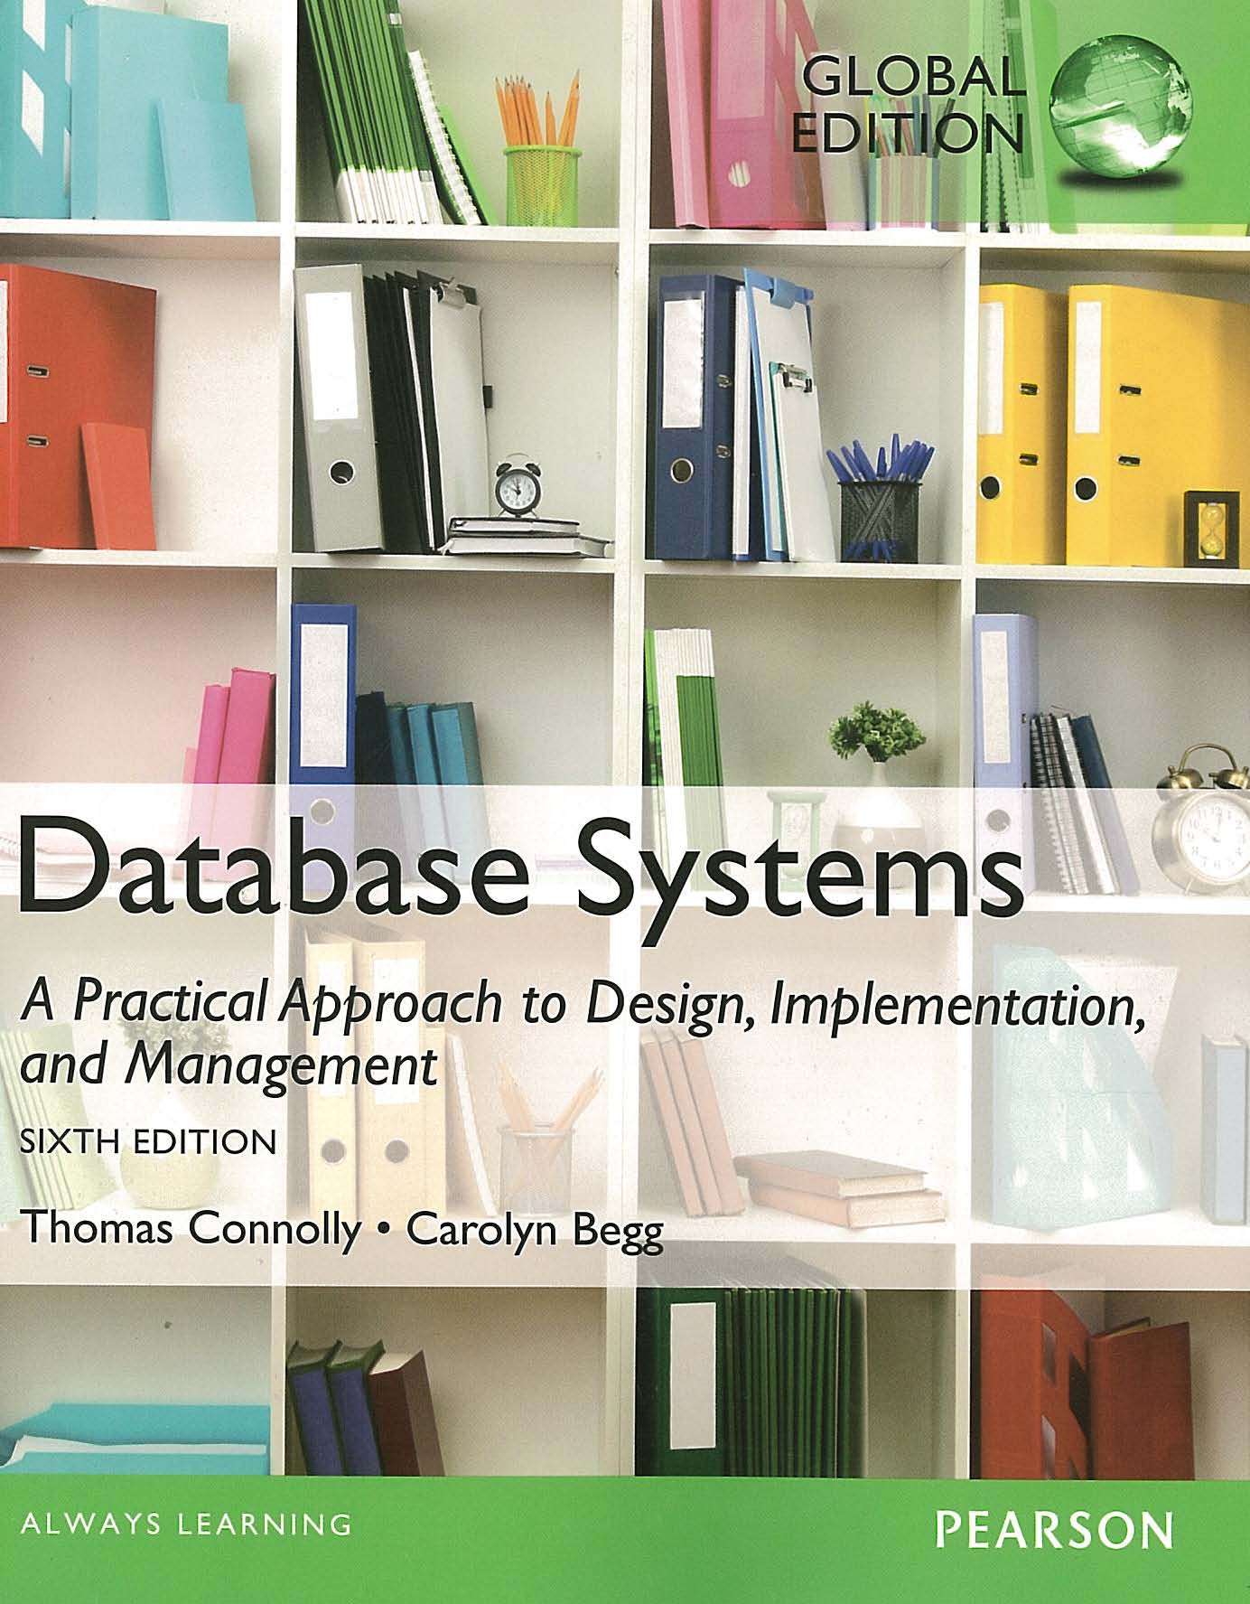
ACKNOWLEDGEMENT
These slides have been adapted from Thomas Connolly and Carolyn Begg. 2015. Database Systems: A Practical Approach To Design, Implementation, and Management. Pearson Education. USA. ISBN:978-1-292-06118-4

Slide 4
CHAPTER 8 ADVANCED SQL

Slide 5

LEARNING OBJECTIVES
How to use the SQL programming language
How to use SQL cursors
How to create stored procedures
How to create triggers
How to use triggers to enforce integrity constraints
The advantages and disadvantages of triggers
How to use recursive queries
vtraining-msuhandi.blogspot.com

Slide 6
The SQL Programming Language
Impedance mismatch
Mixing different programming paradigms
SQL is a declarative language
High-level language such as C is a procedural language
SQL and 3GLs use different models to represent data
SQL/PSM (Persistent Stored Modules)
PL/SQL (Procedural Language/SQL)
Oracle’s procedural extension to SQL
Two versions

Slide 7
Declarations
Variables and constant variables must be declared before they can be referenced
Possible to declare a variable as NOT NULL
%TYPE – variable same type as a column
vStaffNo Staff.staffNo%TYPE;
%ROWTYPE – variable same type as an entire row
vStaffNo1 Staff%ROWTYPE;

Slide 8
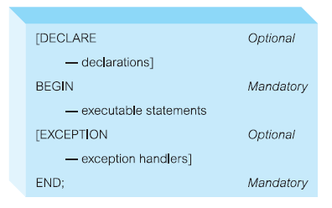
Declarations

Slide 9
Assignments
Variables can be assigned in two ways:
Using the normal assignment statement (:=):
vStaffNo := ‘SG14’;
Using an SQL SELECT or FETCH statement:
SELECT COUNT(*) INTO x
FROM PropertyForRent
WHERE staffNo = vStaffNo;

Slide 10
Control Statements
Conditional IF statement
Conditional CASE statement
Iteration statement (LOOP)
Iteration statement (WHILE and REPEAT)
Iteration statement (FOR)

Slide 11
Conditional IF Statement
IF (position = ‘Manager’) THEN
salary := salary*1.05;
ELSE
salary := salary*1.03;
END IF;
Conditional CASE Statement
UPDATE Staff
SET salary = CASE
WHEN position = ‘Manager’
THEN salary * 1.05
ELSE
salary * 1.02
END;

Slide 12
Iteration Statement (LOOP)
x:=1;
myLoop:
LOOP
x := x+1;
IF (x > 3) THEN
EXIT myLoop; --- exit loop now
END LOOP myLoop;
--- control resumes here
y := 2;

Slide 13

Iteration Statement (WHILE and REPEAT)
WHILE (condition) DO
<SQL statement list>
END WHILE [labelName];
REPEAT
<SQL statement list>
UNTIL (condition)
END REPEAT [labelName];
www.recommind.com

Slide 14
Iteration Statement (FOR)
myLoop1:
FOR iStaff AS SELECT COUNT(*) FROM PropertyForRent WHERE staffNo = ‘SG14’ DO
…..
END FOR myLoop1;

Slide 15
Exceptions in PL/SQL
Exception
Identifier in PL/SQL
Raised during the execution of a block
Terminates block’s main body of actions
Exception handlers
Separate routines that handle raised exceptions
User-defined exception
Defined in the declarative part of a PL/SQL block

Slide 16
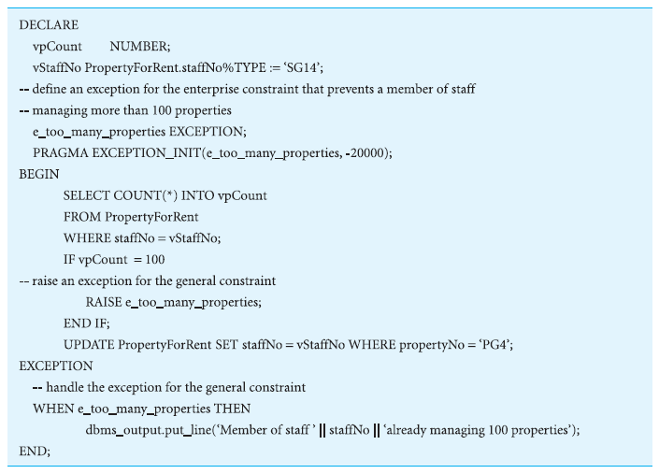
Example of Exception Handling in PL/SQL

Slide 17
Condition Handling
Define a handler by:
Specifying its type
Exception and completion conditions it can resolve
Action it takes to do so
Handler is activated:
When it is the most appropriate handler for the condition that has been raised by the SQL statement

Slide 18
The DECLARE . . . HANDLER Statement
DECLARE {CONTINUE | EXIT | UNDO} HANDLER FOR SQLSTATE {sqlstateValue | conditionName | SQLEXCEPTION |SQLWARNING | NOT FOUND} handlerAction;

Slide 19
Cursors in PL/SQL
Cursor
Allows the rows of a query result to be accessed one at a time
Must be declared and opened before use
Must be closed to deactivate it after it is no longer required
Updating rows through a cursor

Slide 20
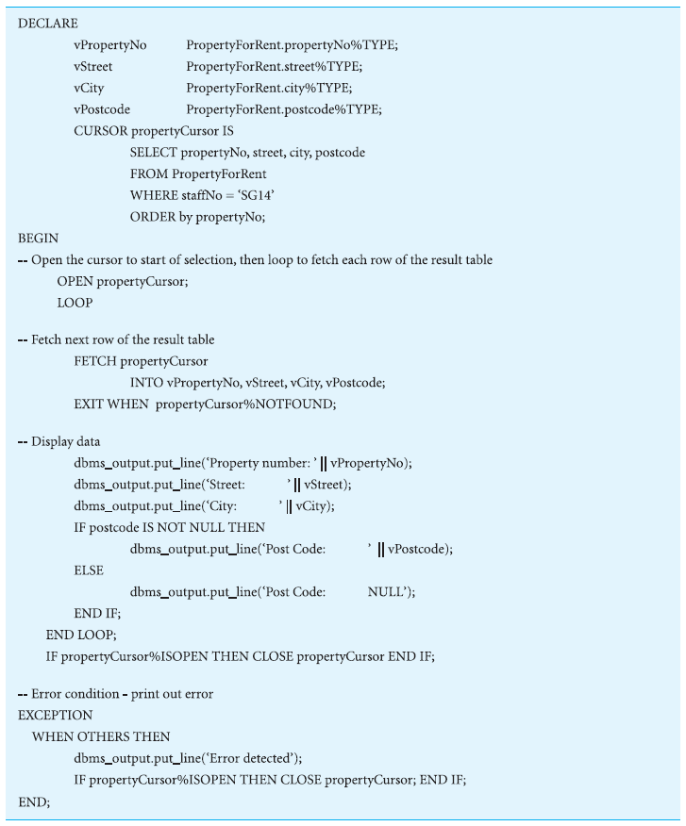
Using Cursors in PL/SQL to Process a Multirow Query

Slide 21
Subprograms, Stored Procedures, Functions, and Packages
Subprograms
Named PL/SQL blocks that can take parameters and be invoked
Two types:
Stored procedures
Functions (returns a single value to caller)
Can take a set of parameters
Each has name and data type
Can be designated as IN, OUT, IN OUT

Slide 22
Subprograms, Stored Procedures, Functions, and Packages
Package
Collection of procedures, functions, variables, and SQL statements that are grouped together and stored as a single program unit
Specification
Declares all public constructs of the package
Body
Defines all constructs (public and private) of the package

Slide 23
Triggers
Trigger
Defines an action that the database should take when some event occurs in the application
Based on Event-Condition-Action (ECA) model
Types
Row-level
Statement-level
Event: INSERT, UPDATE or DELETE
Timing: BEFORE, AFTER or INSTEAD OF
Advantages and disadvantages of triggers

Slide 24

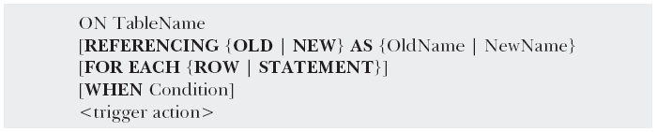
Trigger Format

Slide 25
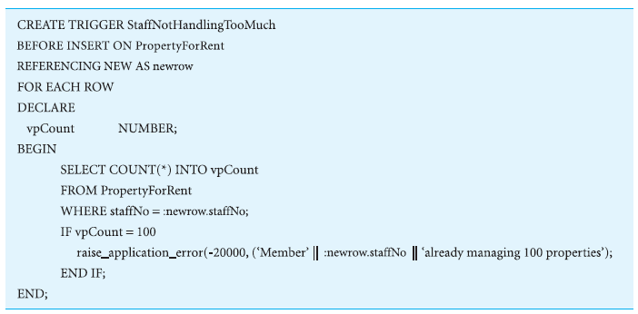
Using a BEFORE Trigger

Slide 26

Advantages & Disadvantages of Triggers
Elimination of redundant code
Simplifying modifications
Increased security
Improved integrity
Improved processing power
Good fit with client-server architecture
Performance overhead
Cascading effects
Cannot be scheduled
Less portable
www.impressico.com

Slide 27
Recursion
Extremely difficult to handle recursive queries
Queries about relationships that a relation has with itself (directly or indirectly)
WITH RECURSIVE statement handles this
Infinite loop can occur unless the cycle can be detected
CYCLE clause

Slide 28
Recursion - Example
WITH RECURSIVE
AllManagers (staffNo, managerStaffNo) AS
(SELECT staffNo, managerStaffNo
FROM Staff
UNION
SELECT in.staffNo, out.managerStaffNo
FROM AllManagers in, Staff out
WHERE in.managerStaffNo = out.staffNo);
SELECT * FROM AllManagers
ORDER BY staffNo, managerStaffNo;

Slide 29

www.healthytravelblog.com

